Slide 1

F# Domain Specific Languages
Tomas Petricek @tomaspetricek | tomas@tomasp.net

Slide 2
software stacks trainings teaching F# user groups snippets mac and linux cross-platform books and tutorials
F# Software Foundation
F# community open-source MonoDevelop
http://www.fsharp.org
contributions research support consultancy mailing list

Slide 3
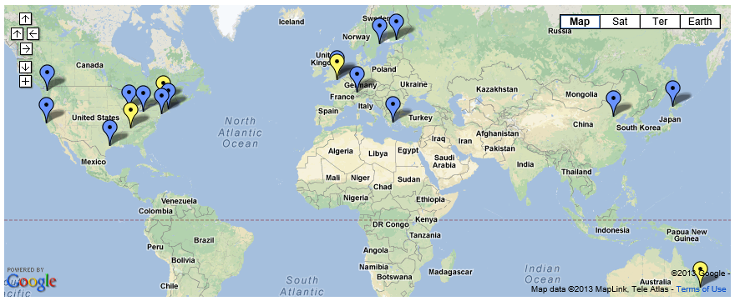
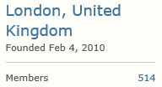

F# Community
http://fsharp.org/groups

Slide 4
F# Users
Time to Market
Kaggle
Interactivity
Machine learning
GameSys
Data processing
Social Gaming
Concurrency
TrayPort
Complexity
Efficiency
Credit Suisse
Complexity
DSLs
Trading screen
Financial models
http://fsharp.org/testimonials

Slide 5
DEMO DSL for building 3D objects

Slide 6
Domain-specific languages
Class of problems
Constructing 3D objects
Makefiles, Stock modelling, Testing, …
Internal DSL in F#
Primitives – basic building blocks
Composition – how to put them together

Slide 7
DSL for option pricing

Slide 8
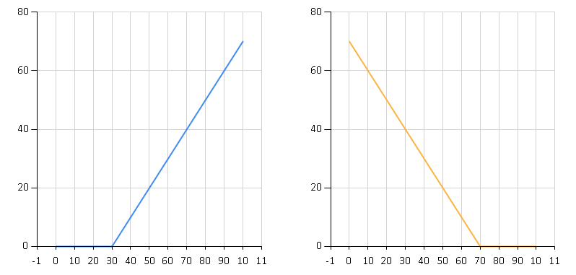
European stock options
Call options
Put options
Option to buy for $30
Option to sell for $30

Slide 9
DEMO Composing stock options

Slide 10
Modeling European options
What is the language?
Primitive values
Composition operations
How do we use the model?
Drawing a pay-off diagram
Calculating option price
Checking for execution

Slide 11
DEMO DSL for building Stock Options

Slide 12
DSL for pattern detection

Slide 13
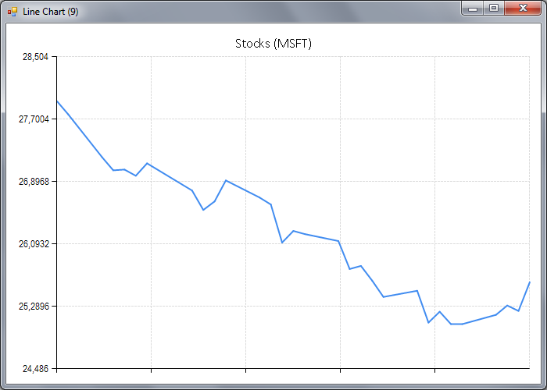
Declining pattern

Slide 14
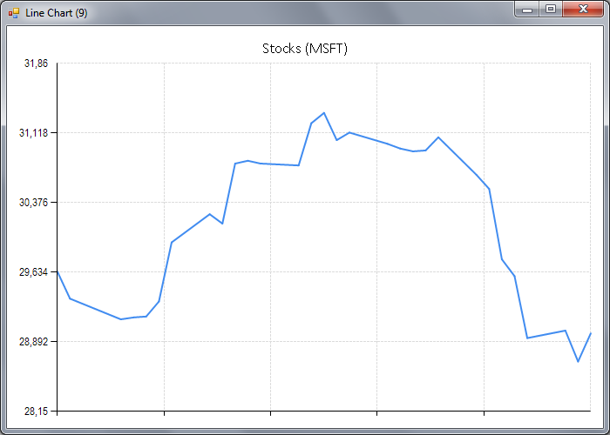
Rounding top pattern

Slide 15
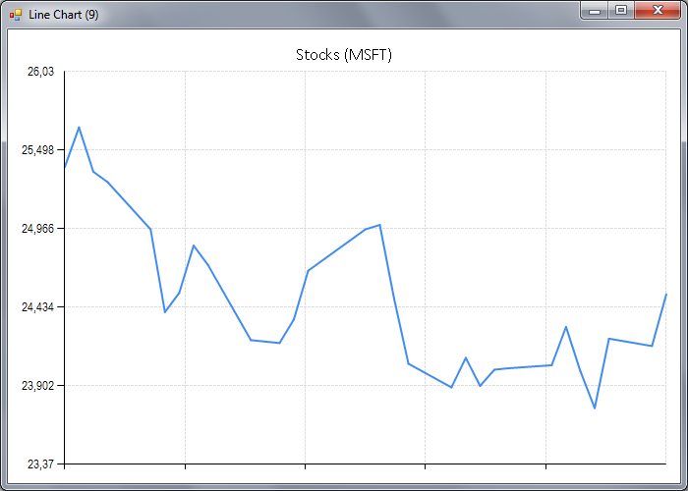
Multiple bottom pattern

Slide 16
Doman-specific language approach
Primitive classifiers
Declining price
Rising price
Combinators for classifiers
Linear regression
Sequence patterns
Parallel patterns

Slide 17
DEMO DSL for detecting price patterns

Slide 18
DSL for charting

Slide 19
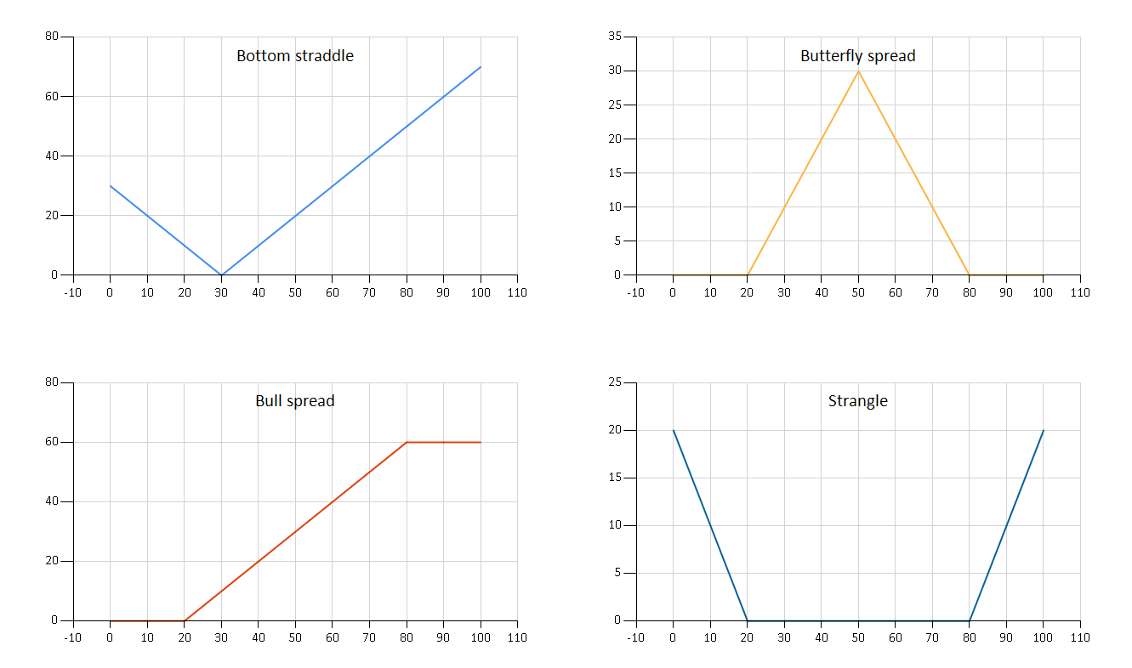
Actually…

Slide 20
Doman-specific language approach
Primitive charts
Line chart, Range chart, …
Bar chart, Column chart, …
Combinators for charts
Side-by-side as rows or columns
Overlay charts in an area
Add title, change colors, …

Slide 21
Summary

Slide 22
How To: Building your own DSL
❶ Understand Primitives and Combinators
❷ Model the language using Discriminated Unions
❸ Add convenient Syntax

Slide 23

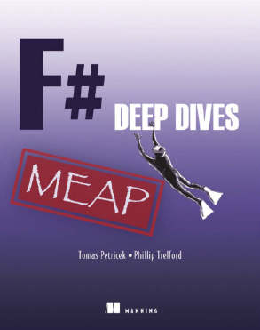
http://fsharp.org software foundation open-source testimonials community
online tutorials http://tryfsharp.org introduction data science visualization finance
industry experts F# Deep Dives domain modeling financial & insurance web & data actor model concurrency social gaming
tomas@tomasp.net consulting Fast Track to F# F# Trainings data processing DSLs asynchronous & concurrent

